Slide 1
WingTipTickets
Azure SQL Database & Azure Search HOL V2.1

Slide 2
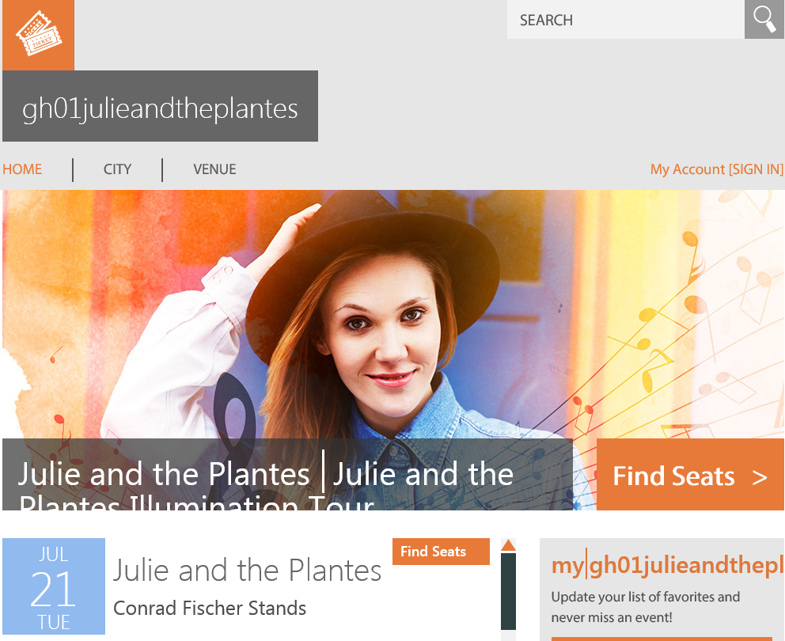
http://gh02julieandtheplantes.trafficmanager.net/

Slide 3
WTT Architecture
Region A
Traffic Manager
Region A
Primary
Azure WebApp
Primary Customer Database
Tables:
Concerts
Customers
Tickets
Venues etc
Geographic Replication
Region A
Secondary
Azure WebApp
Secondary Customer Database
Tables:
Concerts
Customers
Tickets
Venues etc
Region B

Slide 4
Demo scenarios and install steps
Feature | Story
Connectivity | Connect via SSMS to verify DBs
Ticket purchase | WTT is a replica of a online ticket purchasing app
Pay as you go | Create a DB in seconds
Vertical Scaling | Scale-up based on increased DB throughput online
Elastic Database Pools | Anticipation of a big name artist country wide with sale on same day
Auditing | Key Arena DB mysteriously vanished
Point-in-time restore | Accidental DB deletion
Geographic disaster recovery | Server in a datacenter goes down
Transparent Data Encryption | Encrypt sensitive data when stored in a database
Azure Search | What if I want an automated way to assess my historical usage and recommend DB size, SKU size, expected usage etc?
Launch Azure PowerShell (as an administrator)
Add-AzureAccount
Select-AzureSubscription –SubscriptionId <provide your subscription that you want to use>
Set-ExecutionPolicy -Scope LocalMachine -ExecutionPolicy Unrestricted –Force
Switch to the directory where you unzipped scripts.zip e.g. c:\scripts
Unblock-file .\New-WTTEnvironment.ps1
. .\New-WTTEnvironment.ps1
New-WTTEnvironment –WTTEnvironmentApplicationName xx00julieandtheplantes –AzureActiveDirectoryTenantName JoinedTechnology.com
Replace with your initials and some numbers (must be globally unique
Optional for those using AAD

Slide 5
HOL pre-requisites
Prerequisite | Setup instructions
Microsoft account | If you don’t already have a Microsoft account, browse to http://account.live.com, click Sign up now.
Microsoft Azure account | If you don’t already have an Azure account, browse to http://azure.microsoft.com/en-us/pricing/free-trial/ or use an Azure pass, click Try it now.
Microsoft Azure PowerShell | Browse to http://azure.microsoft.com/en-us/downloads/ Under Command-line tools, Windows PowerShell, click Install. Verify that the version being installed is at least 0.9.3 (released June 5, 2015).
Deployment scripts | Navigate to https://github.com/guyhay/WingTipTickets download ZIP package and unzip to a local folder (for example, c:\scripts)
Microsoft Power Query for Excel (optional) | If Power Query for Excel is not installed, and you’d like to complete the Auditing section in the hands-on lab (HOL) manual, download and install Power Query from https://www.microsoft.com/en-us/download/details.aspx?id=39379.
Microsoft SQL Server Management Studio (optional) | If SQL Server Management Studio is not installed, and you’d like to run queries against the databases, download and install SQL Server Management Studio from https://www.microsoft.com/en-us/download/details.aspx?id=42299. The package is listed as SQLManagementStudio_<X86/X64>_ENU.exe
Microsoft Visual Studio (optional) | If Visual Studio is not installed, and you’d like to explore any of the source code, download and install Visual Studio from http://go.microsoft.com/?linkid=9832446&clcid=0x409
Microsoft Azure .NET SDK (if installing Visual Studio) | Browse to http://azure.microsoft.com/en-us/downloads/ Under SDKs, .NET, select the installer for your version Visual Studio e.g. VS 2013 Install.

Slide 6
HOL Key Steps summary
Download and unzip WTTHOL2.1.zip to a local folder e.g. c:\
https://github.com/guyhay/WTT-Demo-Hol
Launch Azure PowerShell (as an administrator)
Add-AzureAccount
Select-AzureSubscription –SubscriptionId <provide your subscription that you want to use>
Set-ExecutionPolicy -Scope LocalMachine -ExecutionPolicy Unrestricted –Force
Switch to the directory where you unzipped scripts.zip e.g. c:\scripts
Unblock-file .\New-WTTEnvironment.ps1
. .\New-WTTEnvironment.ps1
New-WTTEnvironment -WTTEnvironmentApplicationName xx00julieandtheplantes

